Slide 1
NPZD-VIRUS MODEL
V
Comment:
The arrows indicate biomass flow through the compartements
Each flow needs to be characterized by parameters and indicates dependence of one compartement on the other.
N→P means: P is dependant on N which will be in dicated in the equation as P*“N“ but then needs sevaral parameters that describe the dependance
Growth is mu
N= nutrients and will be limiting and taken up at a half satuaration velocity
See next page for example of equations for P
Infecting =I
mortality
Lysis (1-infection)
P
Mortality =mp
D
Grazing =gz
Growth = mu
mortality
remineralisation
N
Z

Slide 2

Equations
Comment…all components need to be present 2 times as they are flows of biomass from one to another compartement
dN <- - mu*P*(N/(N+kN)) + ε *N*D
dP <- mu*P*(N/(N+kN)) - I*P*V - gz*P*Z - mp*P
dV <- deltaV*I*P*V – $m_{v}$*V*D
dZ <- gz*P*Z – Z* $m_{z}$*D
dD <- $m_{p}$*P+ P*I*D + P* $m_{p}$*D + V* $m_{v}$*D - ε*N*D
mu=growth
kN=half saturation constant
I=infection rate
gz=grazing rate
mp=phytoplankton mortality
deltaV= virus production

Slide 3

Parameters
UP = $µ max$ f(N)*f (I)*f (T)*P
f (N)=N /N +$K_{N}$
f (I)=( 1−$e^{−a I/ µ max}$)$e^{\text{−}β \text{I}/µ\text{max}}$
f (T)=$e^{\text{−}a\text{|}\text{T}\text{−}\text{Topt}\text{| }}$
$G_{Z}$ =$\frac{\text{gmax}\text{∗}\text{f}\text{ (}\text{T}\text{)∗}\text{Z}\text{ ∗}{ p}^{2}}{p^{2}\text{+}k_{p}^{2}}$

Slide 4
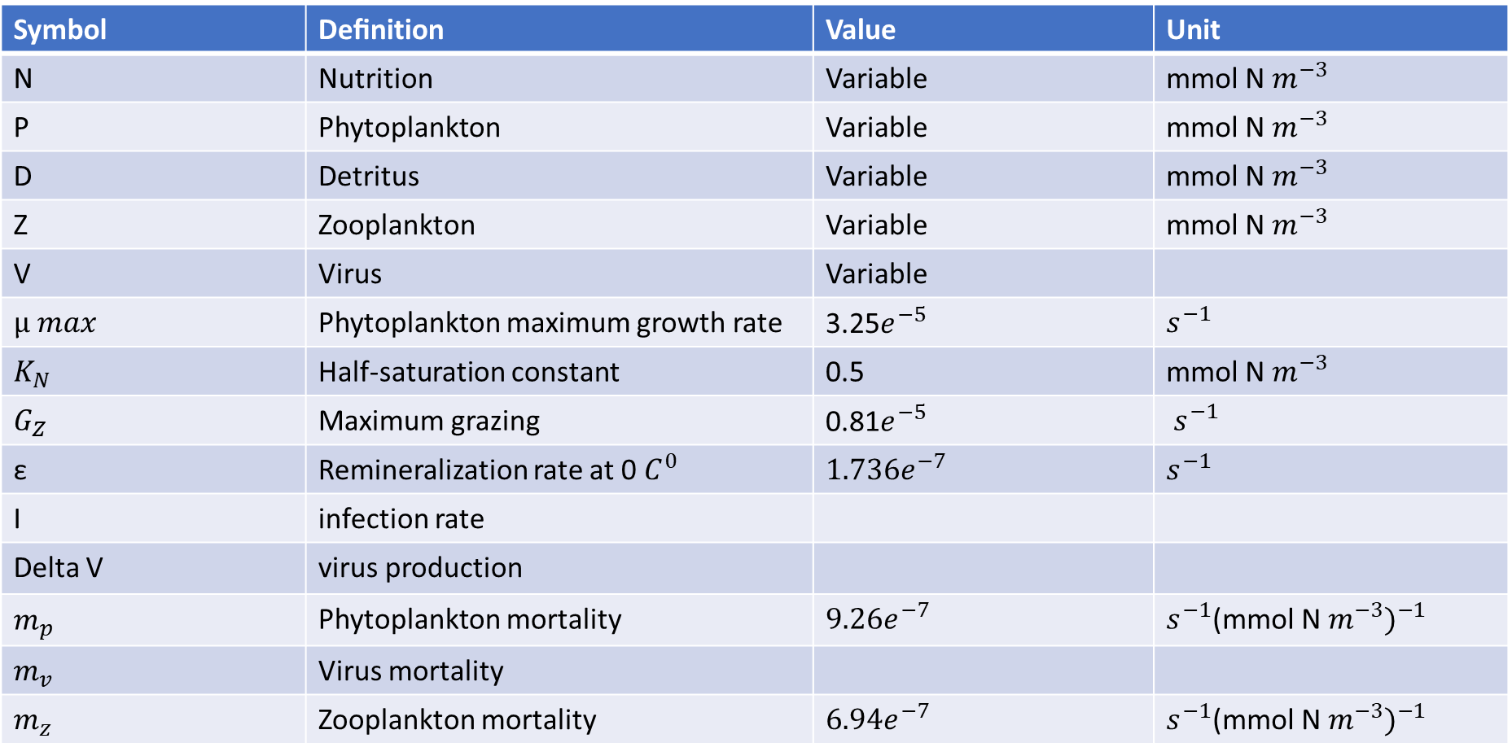
Symbol | Deﬁnition | Value | Unit
N | Nutrition | Variable | mmol N $m^{−3}$
P | Phytoplankton | Variable | mmol N $m^{−3}$
D | Detritus | Variable | mmol N $m^{−3}$
Z | Zooplankton | Variable | mmol N $m^{−3}$
V | Virus | Variable
$µ max$ | Phytoplankton maximum growth rate | 3.25$e^{−5}$ | $$s^{−1}$$
$$K_{N}$$ | Half-saturation constant | 0.5 | mmol N $m^{−3}$
$$G_{Z}$$ | Maximum grazing | 0.81$e^{−5}$ | $s^{−1}$
ε | Remineralization rate at 0 $C^{0}$ | $${1.736e}^{−7}$$ | $$s^{−1}$$
I | infection rate
Delta V | virus production
$$m_{p}$$ | Phytoplankton mortality | $${9.26e}^{−7}$$ | $$s^{−1}{\text{(}\text{mmol} \text{N} m^{−3})}^{−1}$$
$$m_{v}$$ | Virus mortality
$$m_{z}$$ | Zooplankton mortality | $${6.94e}^{−7}$$ | $$s^{−1}{\text{(}\text{mmol} \text{N} m^{−3})}^{−1}$$

Slide 5
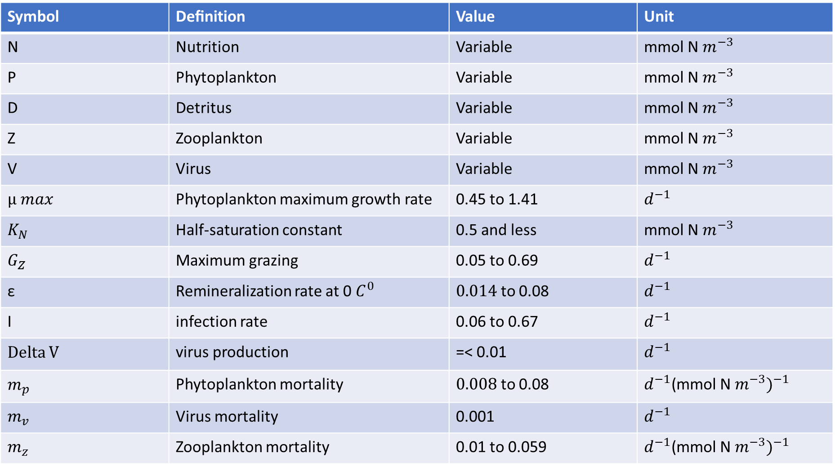
Symbol | Deﬁnition | Value | Unit
N | Nutrition | Variable | mmol N $m^{−3}$
P | Phytoplankton | Variable | mmol N $m^{−3}$
D | Detritus | Variable | mmol N $m^{−3}$
Z | Zooplankton | Variable | mmol N $m^{−3}$
V | Virus | Variable | mmol N $m^{−3}$
$µ max$ | Phytoplankton maximum growth rate | 0.45 to 1.41 | $$d^{−1}$$
$$K_{N}$$ | Half-saturation constant | 0.5 and less | mmol N $m^{−3}$
$$G_{Z}$$ | Maximum grazing | 0.05 to 0.69 | $$d^{−1}$$
ε | Remineralization rate at 0 $C^{0}$ | $0.014$ to 0.08 | $$d^{−1}$$
I | infection rate | 0.06 to 0.67 | $$d^{−1}$$
Delta V | virus production | =< 0.01 | $$d^{−1}$$
$$m_{p}$$ | Phytoplankton mortality | $0.008$ to 0.08 | $$d^{−1}{\text{(}\text{mmol} \text{N} m^{−3})}^{−1}$$
$$m_{v}$$ | Virus mortality | 0.001 | $$d^{−1}$$
$$m_{z}$$ | Zooplankton mortality | 0.01 to 0.059 | $$d^{−1}{\text{(}\text{mmol} \text{N} m^{−3})}^{−1}$$

